Slide 1
Kalamazoo Route Planner
Client: Modeshift Kalamazoo - Dustin Black
Members: Austin Miller, Bjarne Wilken, Christian Fuentes, Matthew Phillips, Mike Henke
Notes:
Austin

Slide 2

About Our Client:
Modeshift Kalamazoo
A small community that exists to make biking and walking in our neighborhood, a safe and easy transportation choice, for everyday activities.
Notes:
This effort seeks to dismantle the stigma around active transportation and work toward a broader mobility system that works for all.

Slide 3
The Problem
Imagine Kalamazoo in 2025
Make Kalamazoo a more bike friendly city
Develop an application that can plan a route for…
Biking
Walking
Notes:
Austin

Slide 4
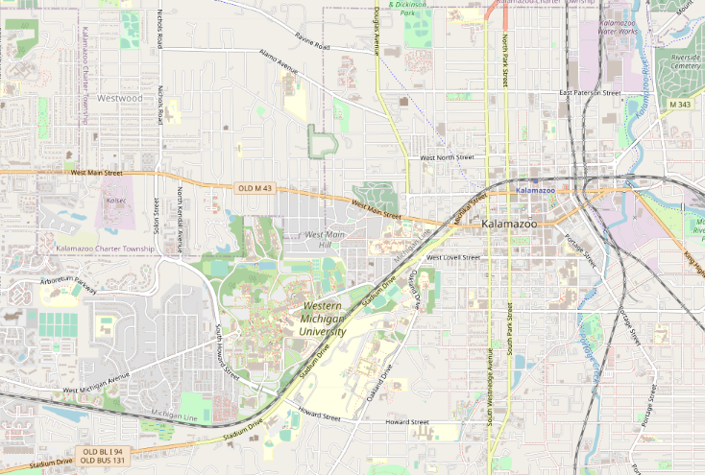
About the
Route Planner UI
Notes:
BDUB

Slide 5
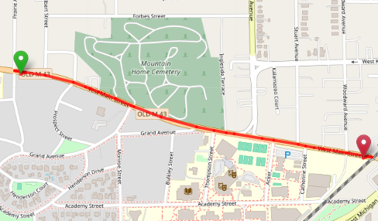
Routing of Kalamazoo
The route planner is a router for the people of Kalamazoo to get their location in area by:
Walking
Bicycle

Slide 6
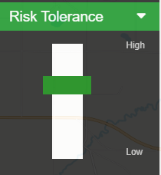
Risk Tolerance
Risk tolerance is the user’s preferred amount of risk they are willing to tolerate.
Paths ranked from 1 to 4
4 is a high risk path
1 is a low risk path
Notes:
BDUB

Slide 7
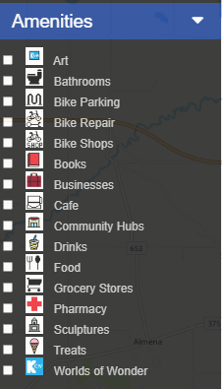
Amenities
A user can select locations from the amenities’ tab. These areas include:
Bike Parking
Bike Shops
Cafes
Pharmacies
Grocery Stores
etc
Notes:
BDUB

Slide 8


Export GPX File
After setting your route. Press this button to create a GPX.
Notes:
BDUB

Slide 9

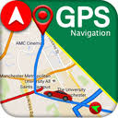

Using a GPX File
Just upload the gpx file to the desired gps application and use it to travel to your destination.
Notes:
BDUB

Slide 10
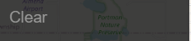
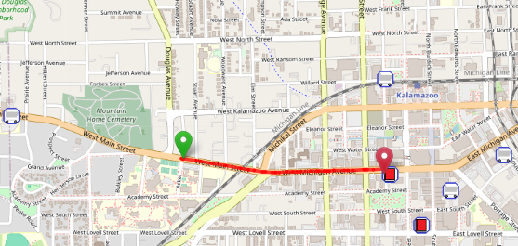
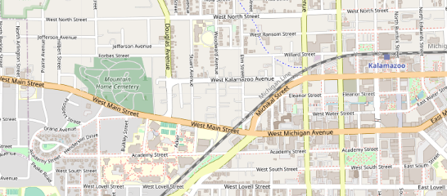
Clear Button
Clears all routes, markers, and deselects all amenities.
Before
After

Slide 11
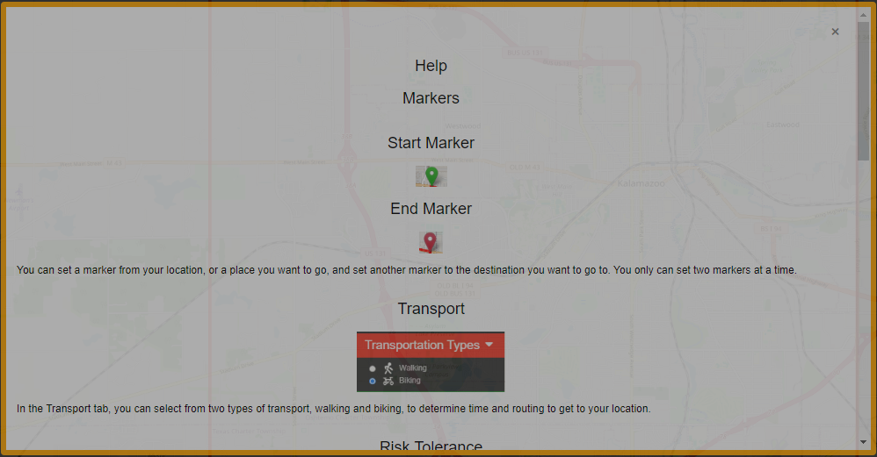
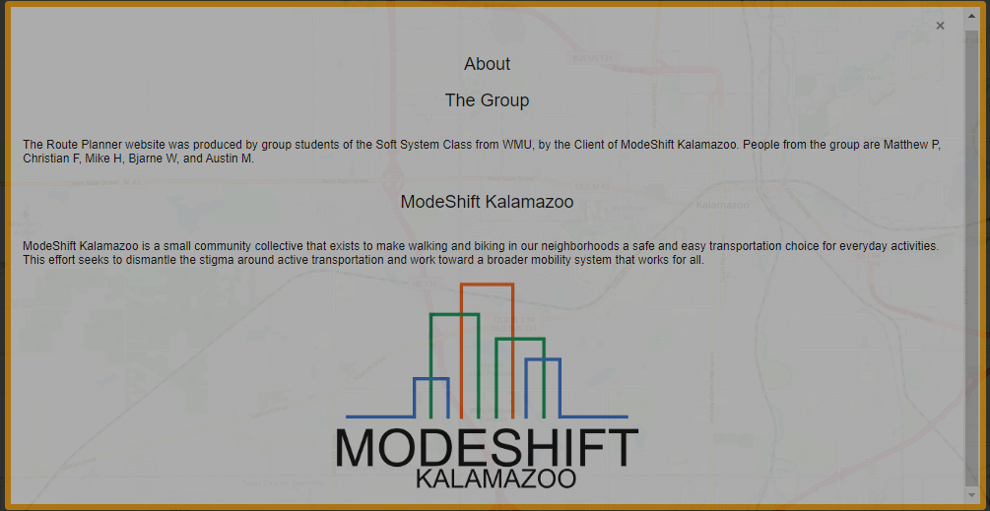
About and Help Pages
The help page explains about how to use the page, and the about page explains about the people, us, and organizations who are affiliated with the project
Help page
About page

Slide 12
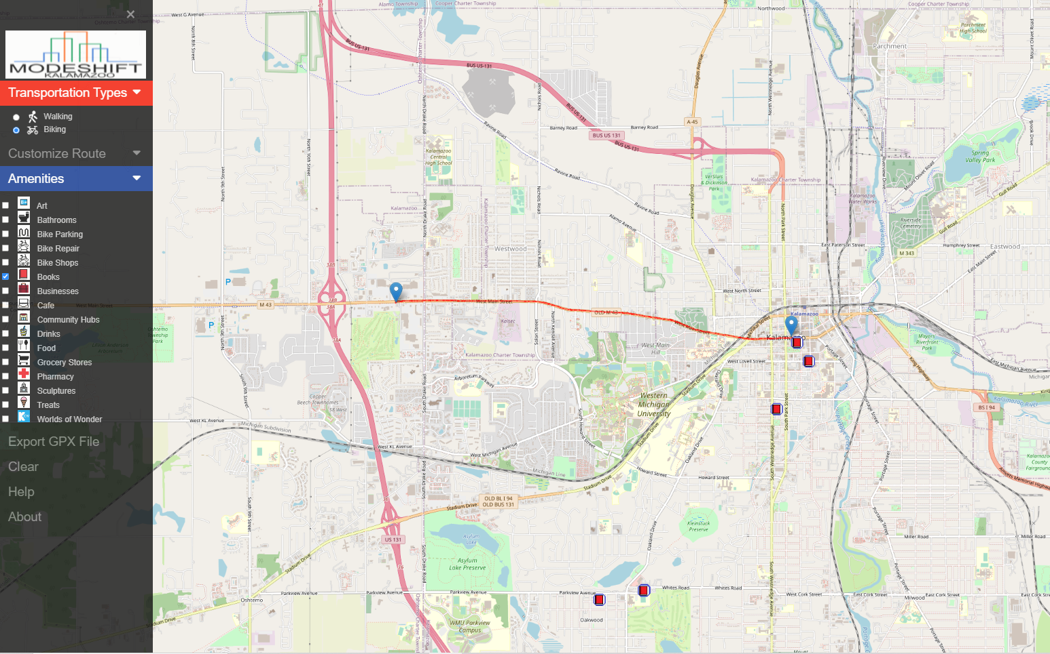
Displaying the map to the user
Utilized the JavaScript library Leaflet to display the map and place markers/amenities/route on the map.

Slide 13
Backend
Notes:
BDUB

Slide 14

Flask
Flask is a micro web framework written in Python. It has no database abstraction layer, form validation, or any other components where pre-existing third-party libraries provide common functions.

Slide 15
Flask
Advantages of Flask​
Lightweight​
Doesn't depend on external libraries​
Provides needed functionality without extra features​
Integrated debugging​
Easy to write​
Quick development time

Slide 16
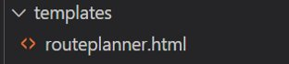
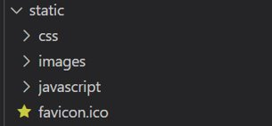
Flask Project Structure
Flask programs have a specific file structure that must be followed for the website components
Templates Folder
HTML
Static Folder
CSS
JavaScript
Images

Slide 17
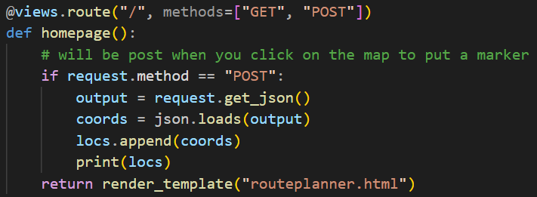
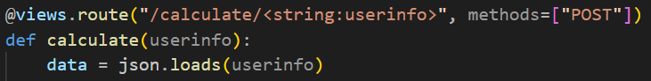
Flask Views
Control the website with views
Check for POST to retrieve information from the website.
Send information from JS back to python

Slide 18
Database
Open Street Maps data
Relational database
SQLite
Ability to change path info
Data is connected

Slide 19
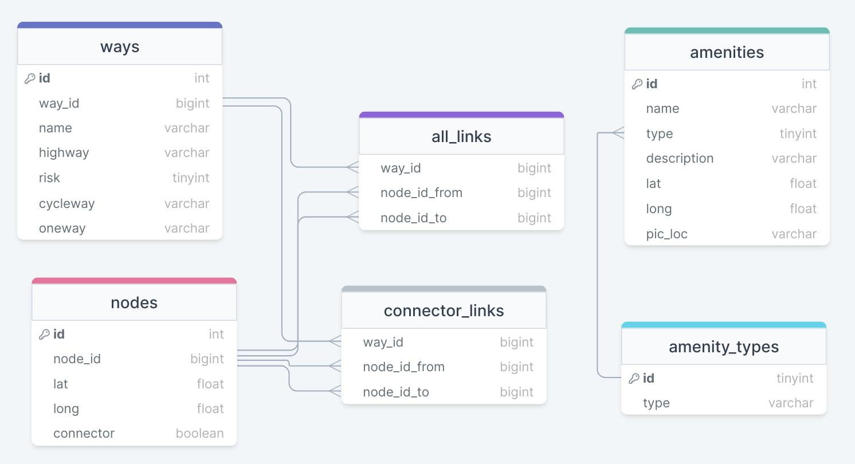
Database Schema

Slide 20
Optimizing the data
Reducing the dataset
All_links ~ 172,000 elements
Connector_links ~ 58,000 elements
67% reduction
Database indexing
Tables
Nodes, ways, connector_links, all_links
Columns
Node_id, way_id, node_id_from, node_id_to

Slide 21
Retrieving the data
Data_retriever class
SQLite connector
Primary functions
Get_neighbors, get_way_info, get_nodes
No assembly of a graph before hand
data_retriever.py

Slide 22
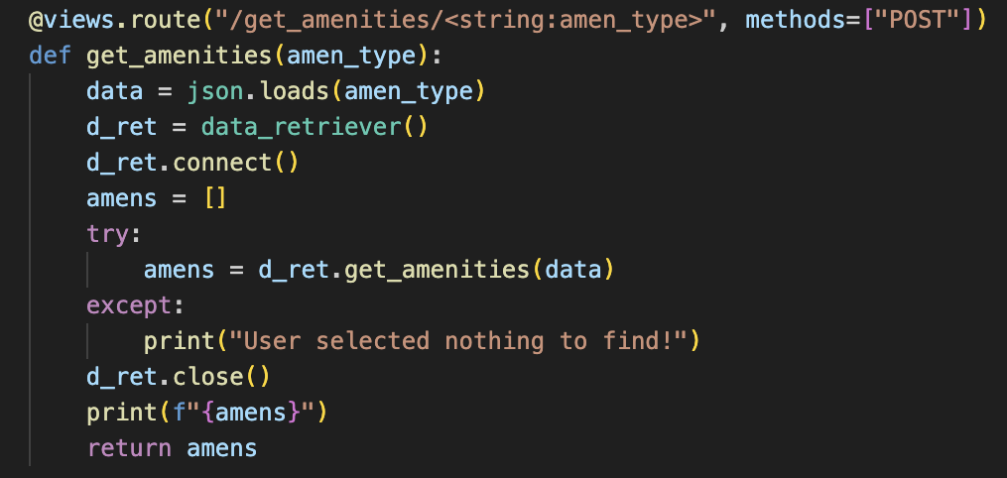
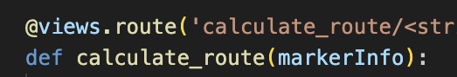
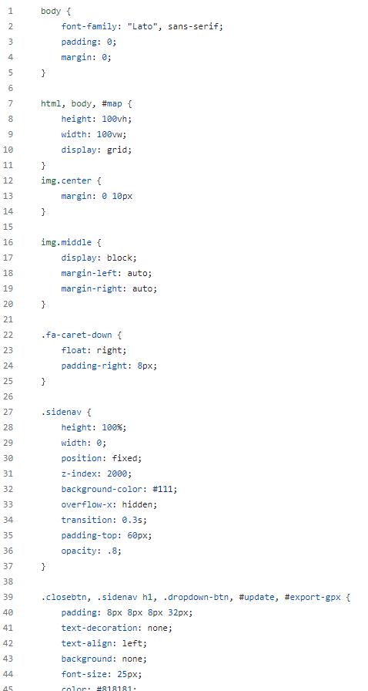

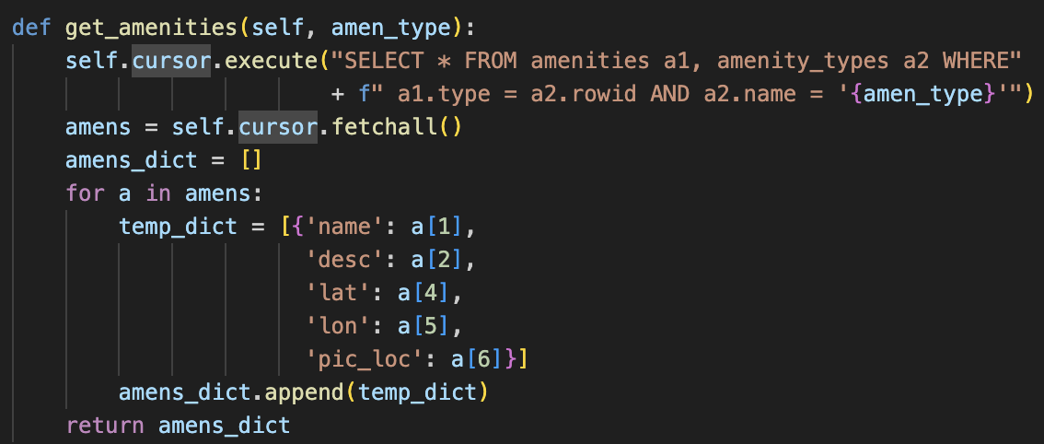
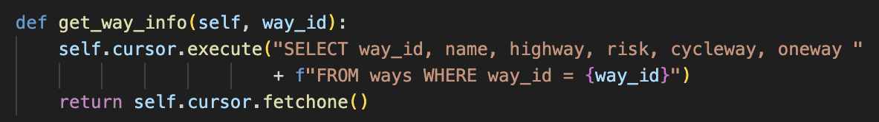
Data_retriever interfacing
Javascript await fetch call
menucss.css
Pathfinder Class
RoutePlanner.html
Different calls
Return Data

Slide 23
Pathfinding
Why A Star
Size of the search area
The amount of nodes
Speed of the algorithm
pathfinder.py

Slide 24
A Star Explained
How it works​
Two lists to keep track of nodes
Move to the closest node
Get that nodes neighbors
Check if the target is one of the neighbors
repeat
pathfinder.py

Slide 25
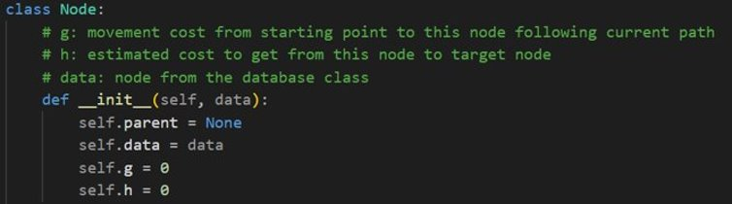
Pathfinding
Distance calculation with Python GeoPy library
Nodes take into account a risk tolerance
Builds final path from the target node once found
Node class
pathfinder.py

Slide 26
Risk Testing
Notes:
BDUB

Slide 27
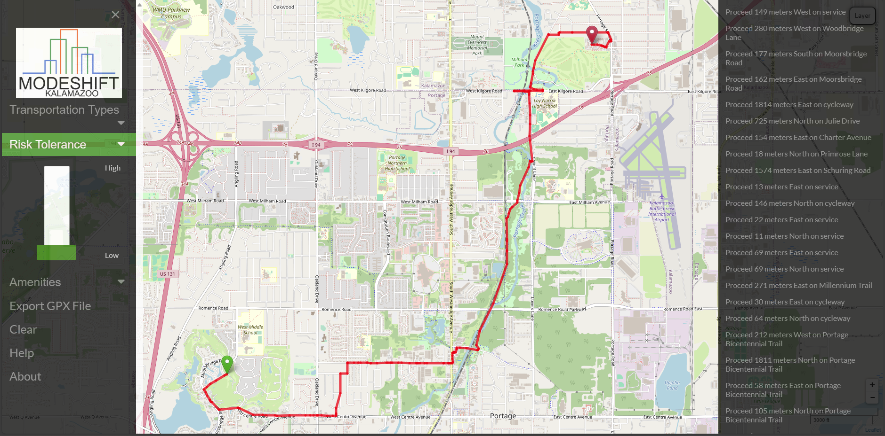
Testing Example
Testing Example on a Route with different Risk Factors
Low Risk Tolerance ( 1 )

Slide 28
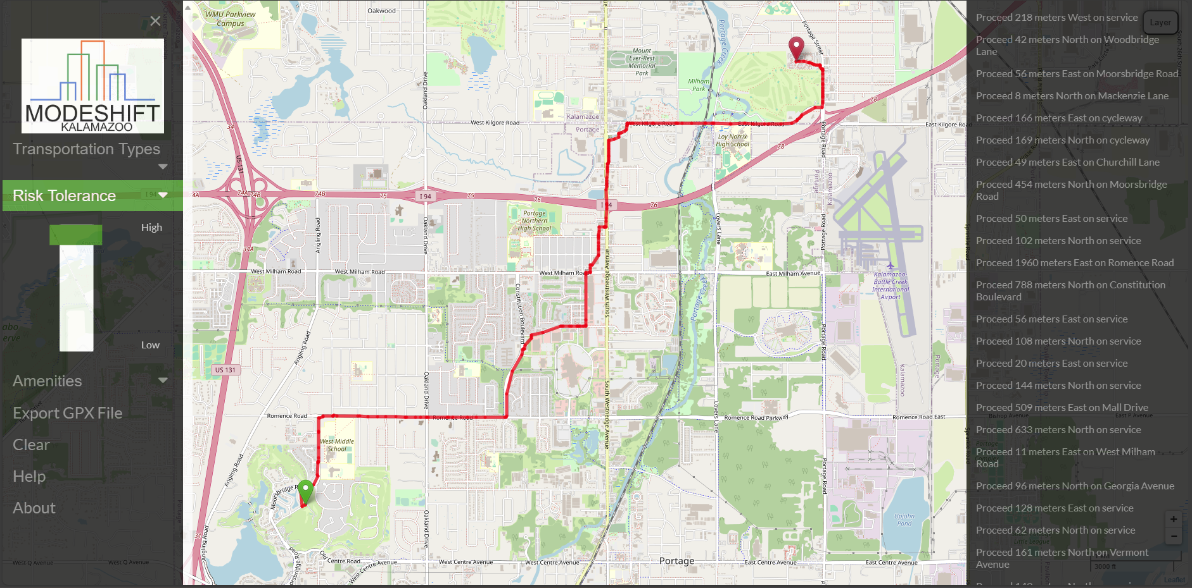
Testing Example
Testing Example on a Route with different Risk Factors
High Risk Tolerance ( 4 )

Slide 29
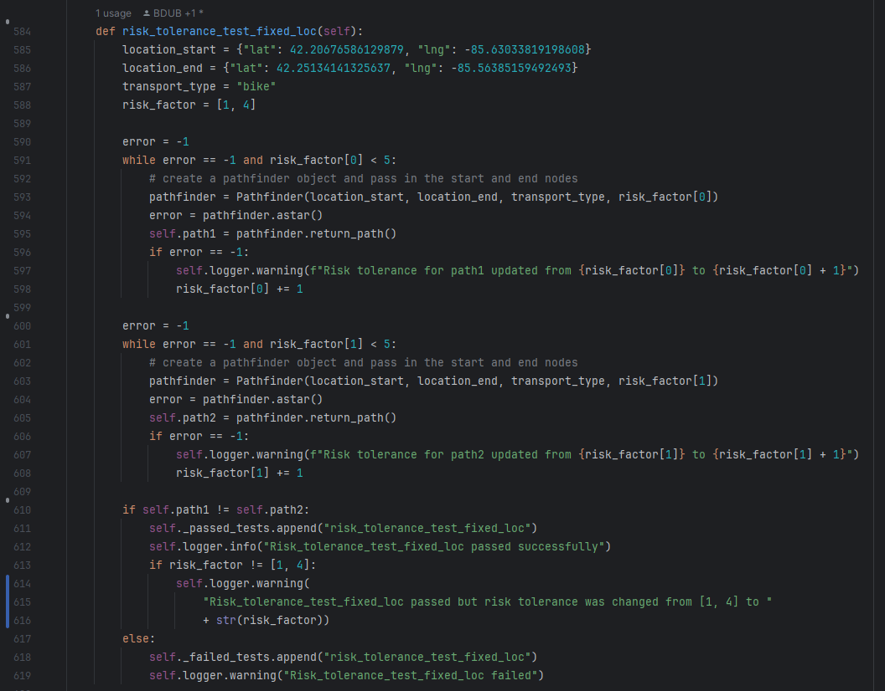
Testing Example - CODE
Testing Example on a Route with different Risk Factors
Set parameters for pathfinder
Call Pathfinder with Parameters
Check if Paths are different
Log Results

Slide 30

Testing Example - Results
Passed ?
Risk Tolerance change (why)
No Path possible ?

Slide 31
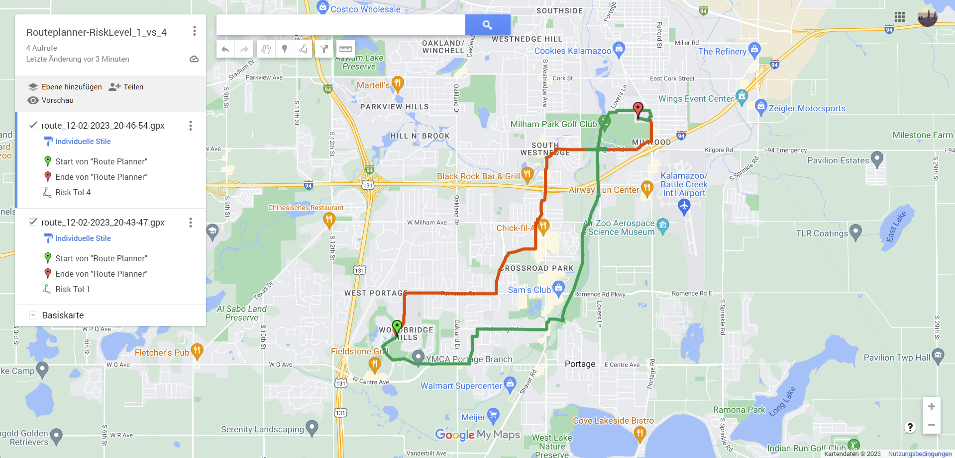
Testing Example - Results
Low Risk Tolerance (Green) vs High Risk Tolerance (Red)

Slide 32
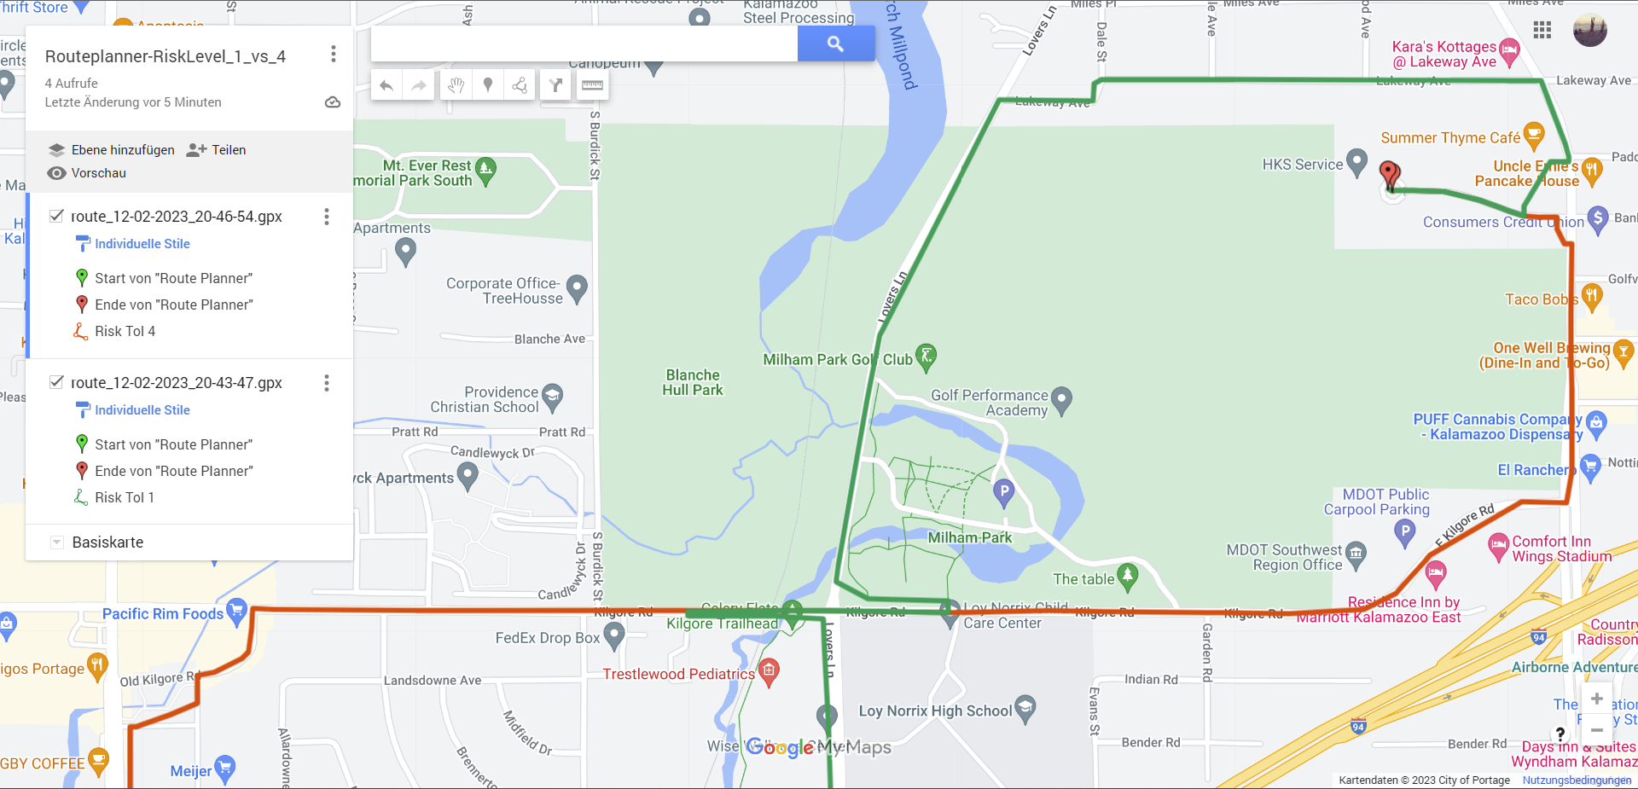
Testing Example - Differences
Low Risk Tolerance (Green) vs High Risk Tolerance (Red)

Slide 33
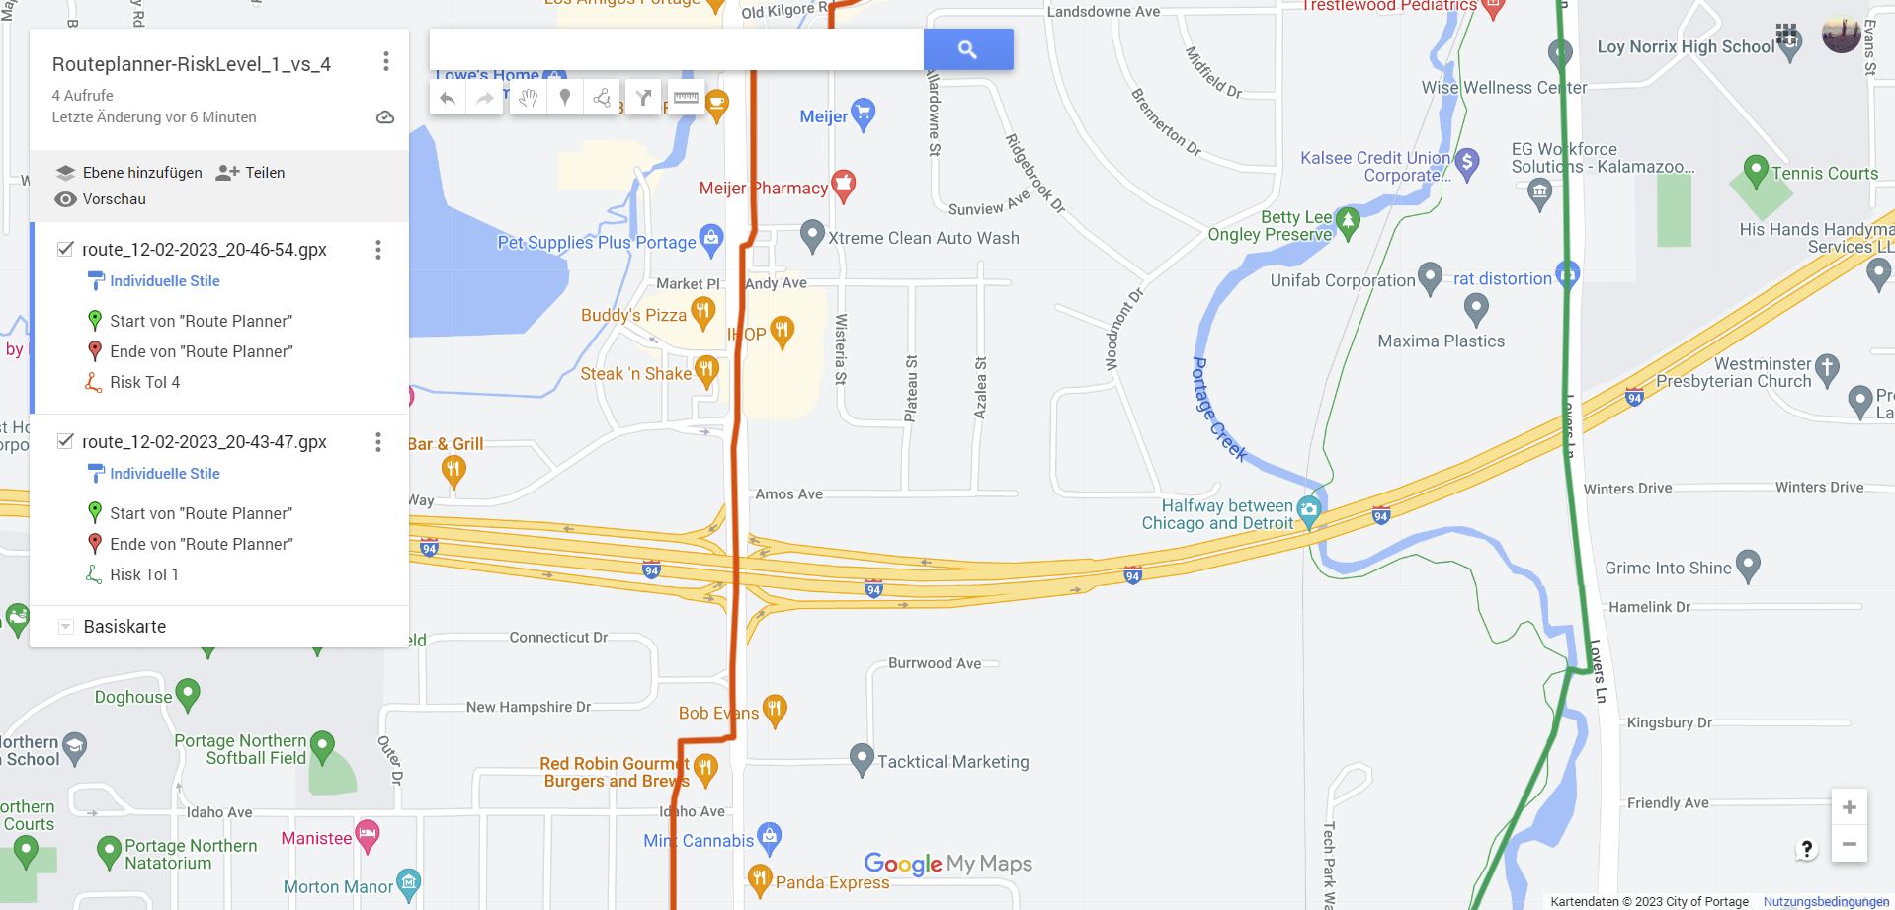
Testing Example - Differences
Low Risk Tolerance (Green) vs High Risk Tolerance (Red)

Slide 34
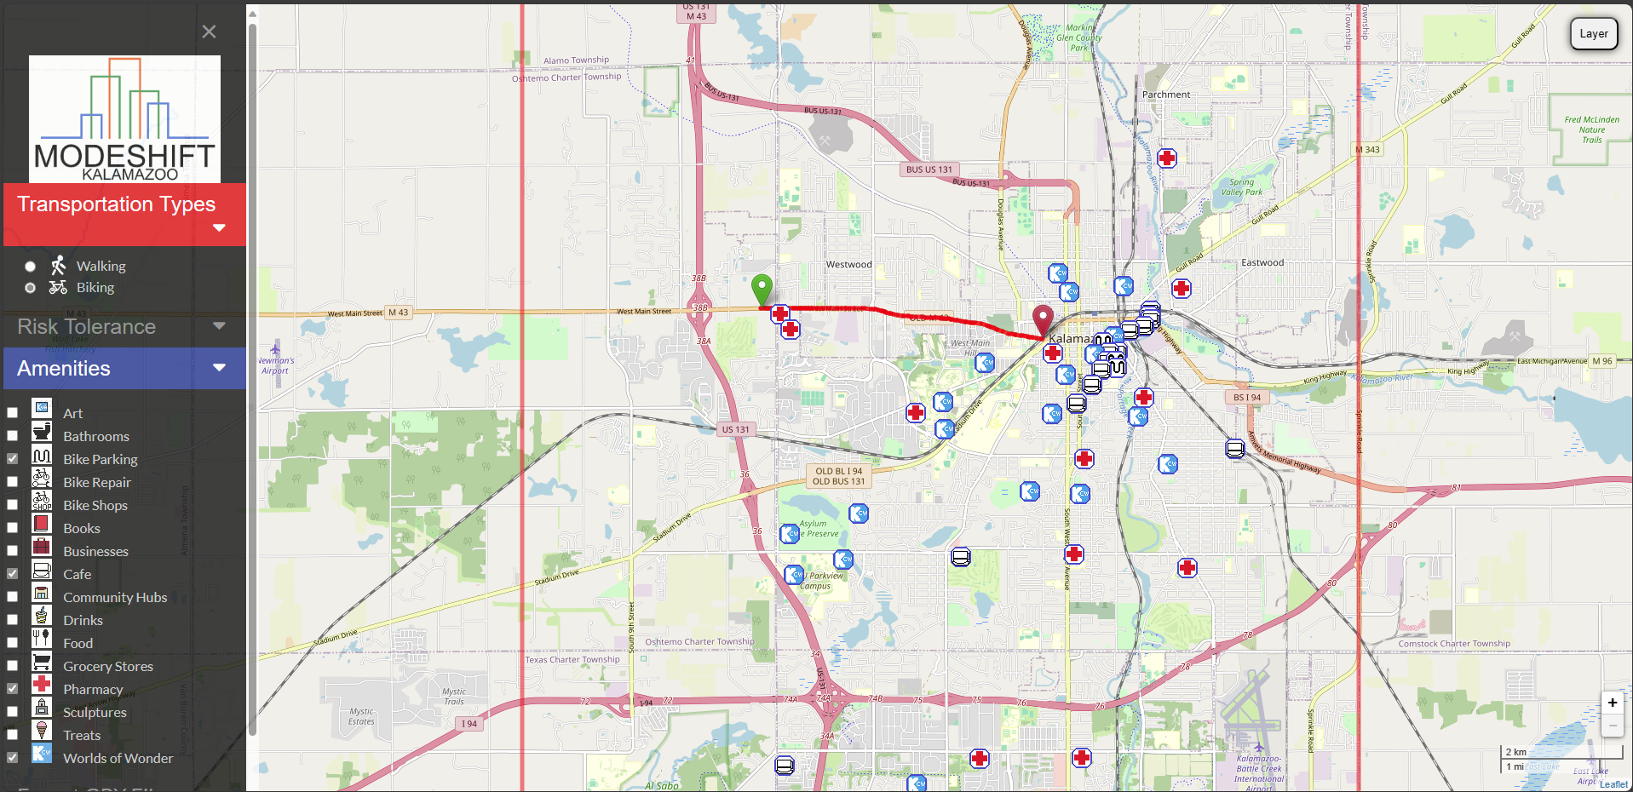
Here’s a Live Example of the Application

Slide 35
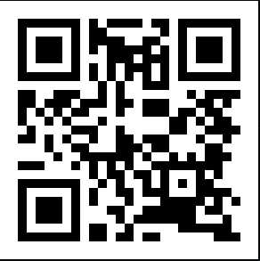
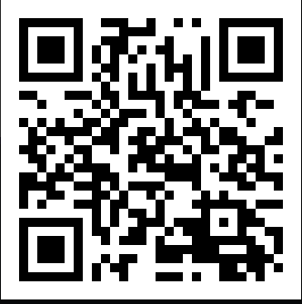
Thank You
Website:
Try it out yourself
Github:
Where all the magic happens

